Slide 1

파워포인트 클래스
2017
Instructor : Kevin Choi
주관 : 중앙 문화 센터

Slide 2
케빈 최의 PowerPoint강좌
ChoiStudy.com
월요일 – 금요일
10am-12.30pm
7pm – 9.30pm
Phone: 213-368-2545
690 Wilshire Place, Los Angeles, CA
Email: choi.study@gmail.com
필요사항
  PowerPoint Program
  USB Memory (4Gb 이상)
Materials
  교재 (강의에 포함)
  .
Notes:
Beginning course details and/or books/materials needed for a class/project.

Slide 3

Introduction/Course Description
파워포인트는 과거 사진이나 차트등을 한장씩 보여주며 하던 각종 프레센테이션을 자동화 하고 동영상, 설명, 사운드, 음악등을 포함시켜 그 효과를 극대화 하여주는 프로그램이다.
Microsoft Office라는 팩키지에 포함되어 함께 팔며, 개인용은 $150 미만, 사무용이나 상업용은 2-3배의 가격이다.
Notes:
Introductory notes.

Slide 4
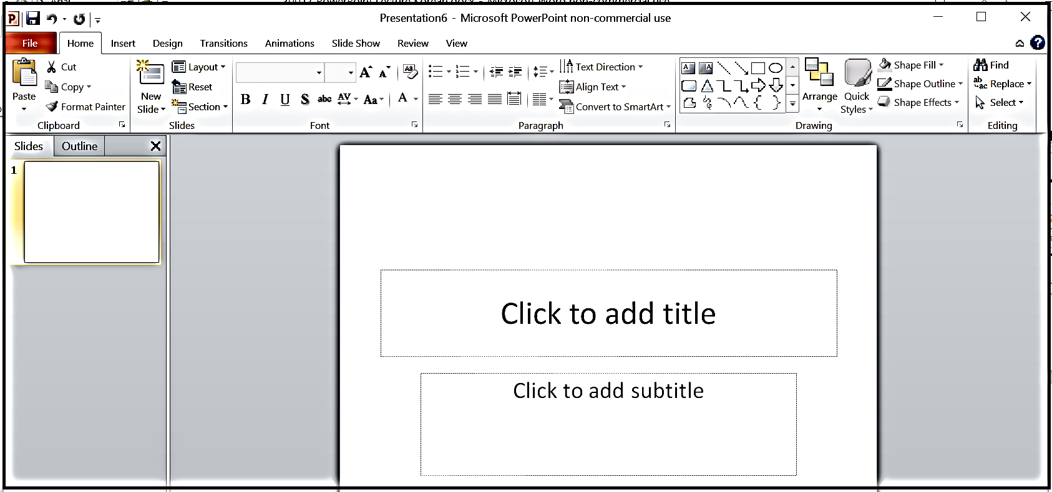
1.파워포인트 시작
Start 혹은 오피스 버튼을 클릭. All Programs 클릭. Office클릭. Power Point 클릭. Presentation 1 – Microsoft PowerPoint 작업창이 오픈된다.

Slide 5
Template 선택
Transitions between Slides
Picture Animations
Text Animations
Sound Effect
Insert Music & Narration

Slide 6
슬라이드쇼 보기
마우스 클릭 콘트롤
슬라이드당 상영 시간
완성된 프레센테이션 작성
CD, USB에 보관
Email용,Computer용, HD 비디오

Slide 7
그래픽 챠트 삽입:

Slide 8
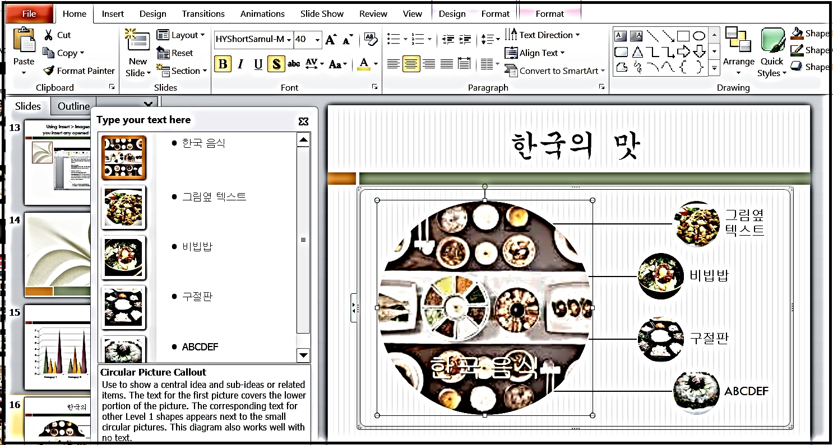
연습하기
Notes:
Conclusion to course, lecture, et al.

Slide 9
Graphs/ Bar
Notes:
Example graph/chart.

Slide 10
Graphs/ Pie
Notes:
Example graph/chart.

Slide 11
한국의 맛
여러가지 도표 추가하기 : Insert > SmartArt
한국 음식
비빕밥
구절판
ABCDEF
그림옆 텍스트

Slide 12
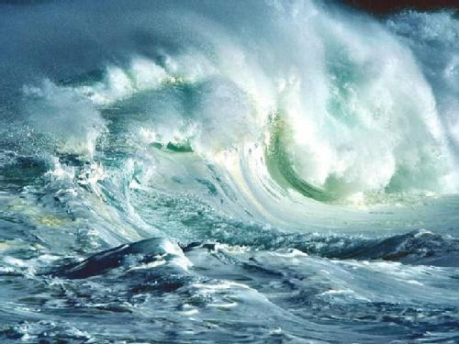
사진 삽입

Slide 13
Photo Album 추가
Photo Album:
계속된 사진 여러장을 한번에 삽입한다.

Slide 14
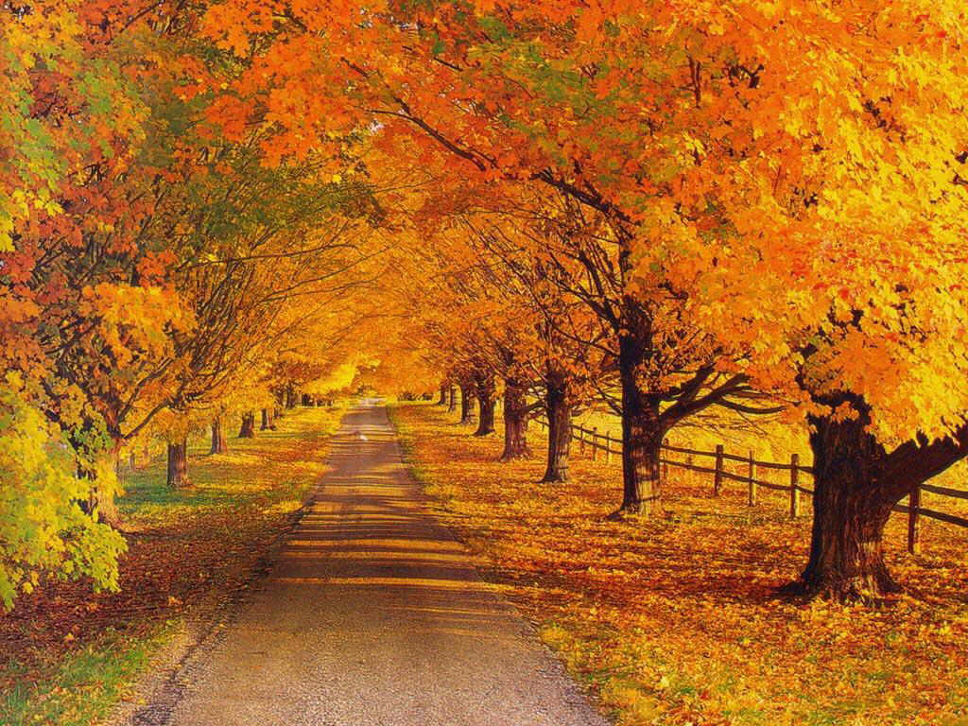

Slide 15
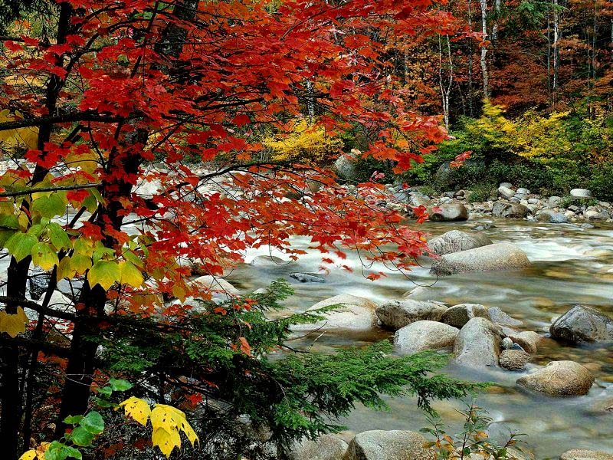

Slide 16
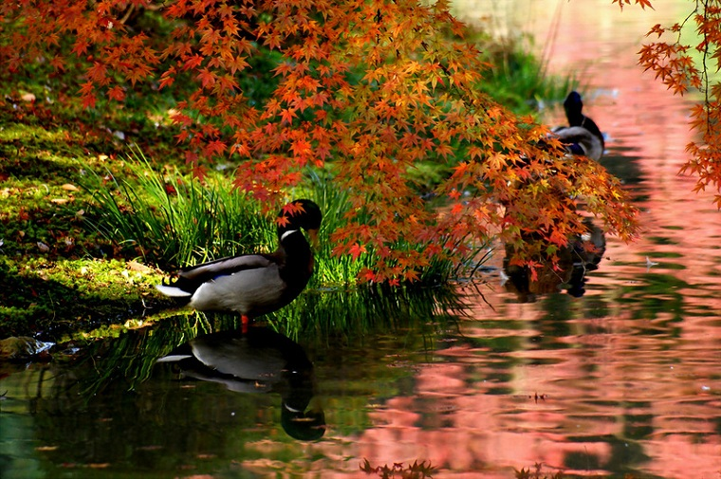

Slide 17
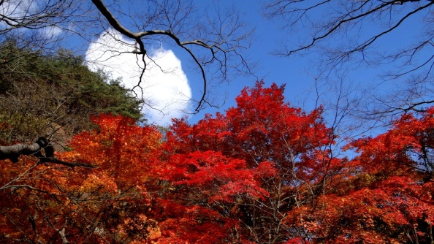

Slide 18
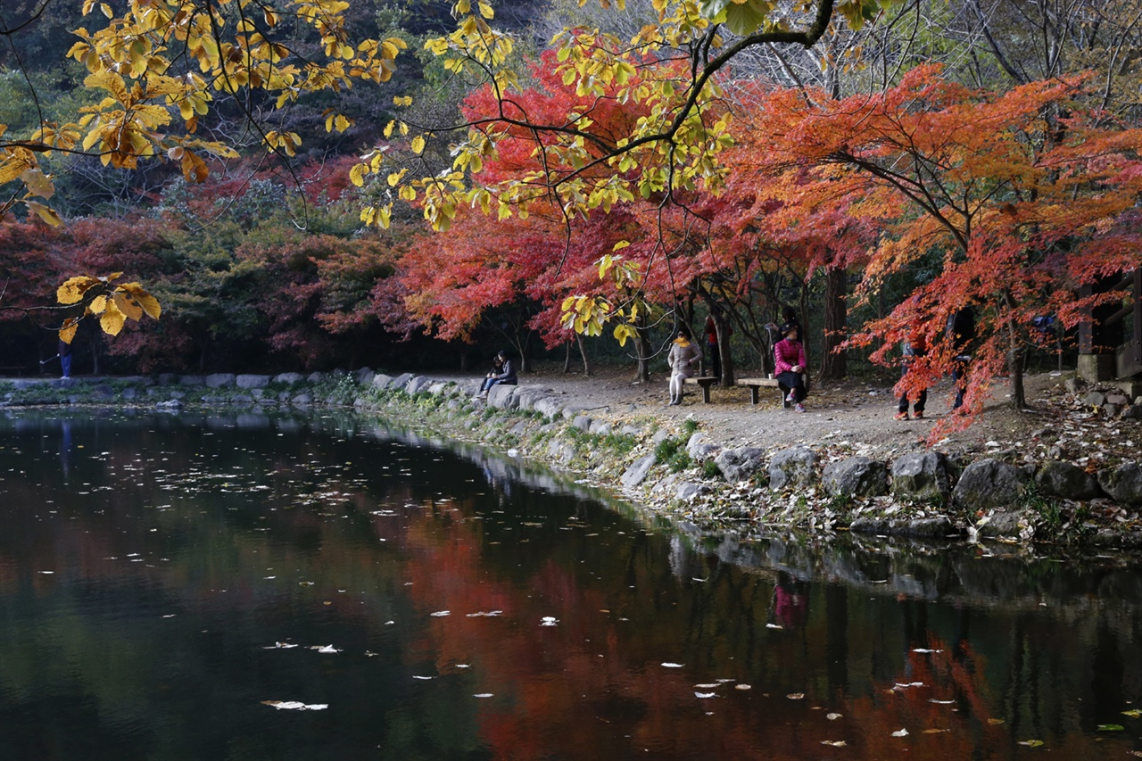

Slide 19


Slide 20


Slide 21
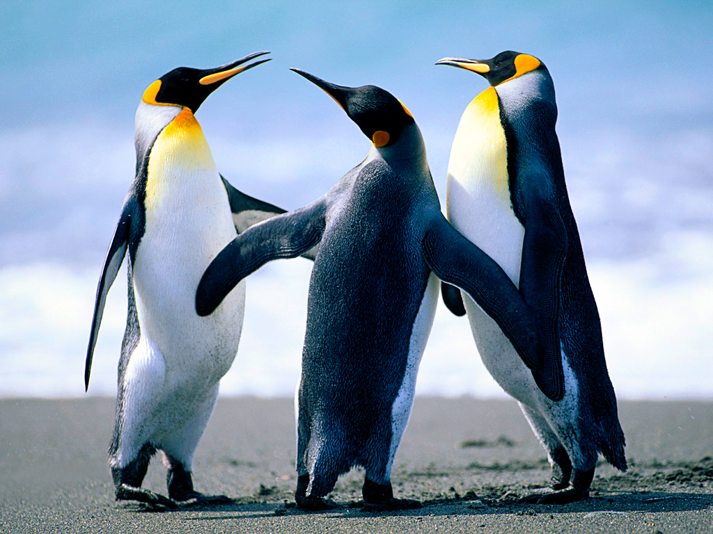
애니메이션을 사용한 펭귄쇼

Slide 22
여러가지 템플릿의 사용
Power Point Program 에는 수십개의 기존 바탕 화면이 준비되어 있다.
File 메뉴에서 New를 클릭하여 원하는 템플릿을 불러온다.

Slide 23
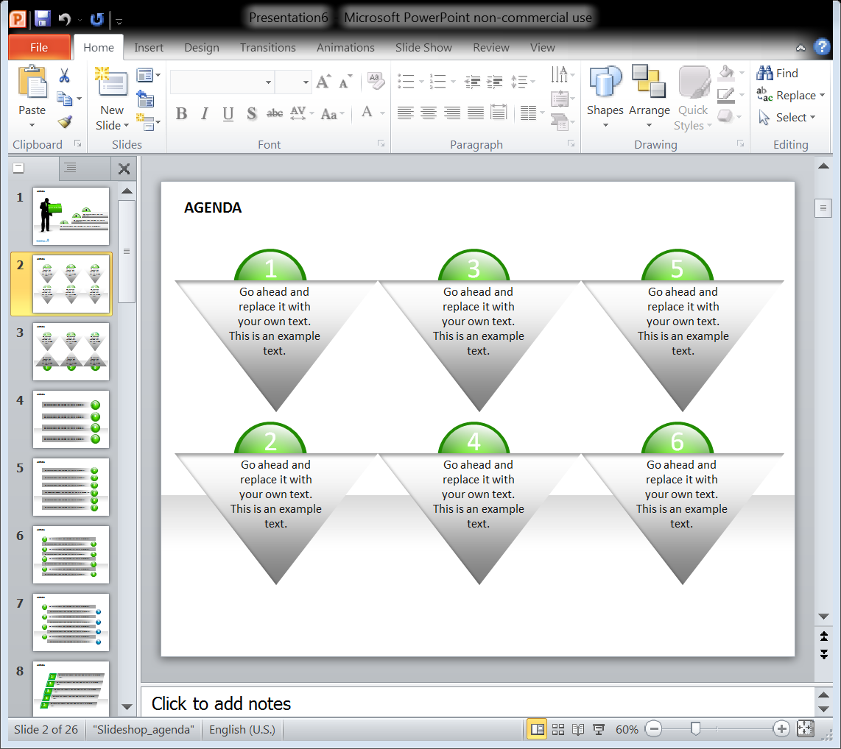

Slide 24
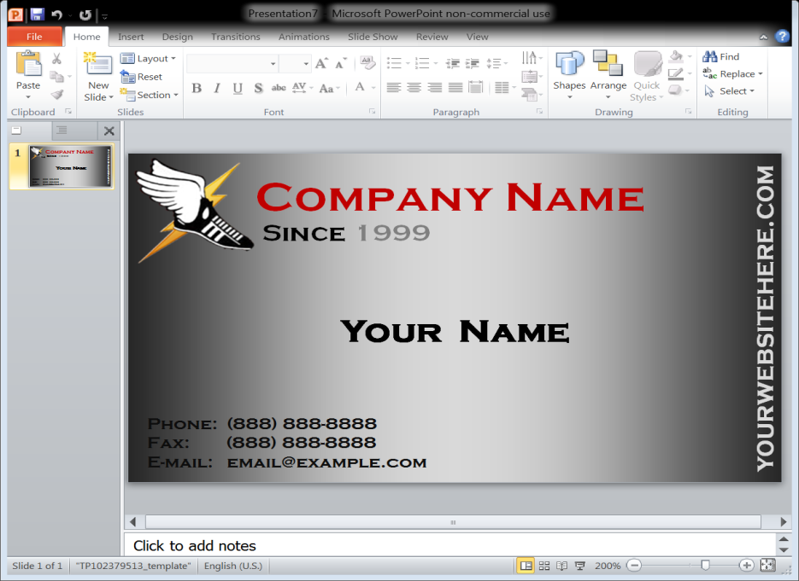
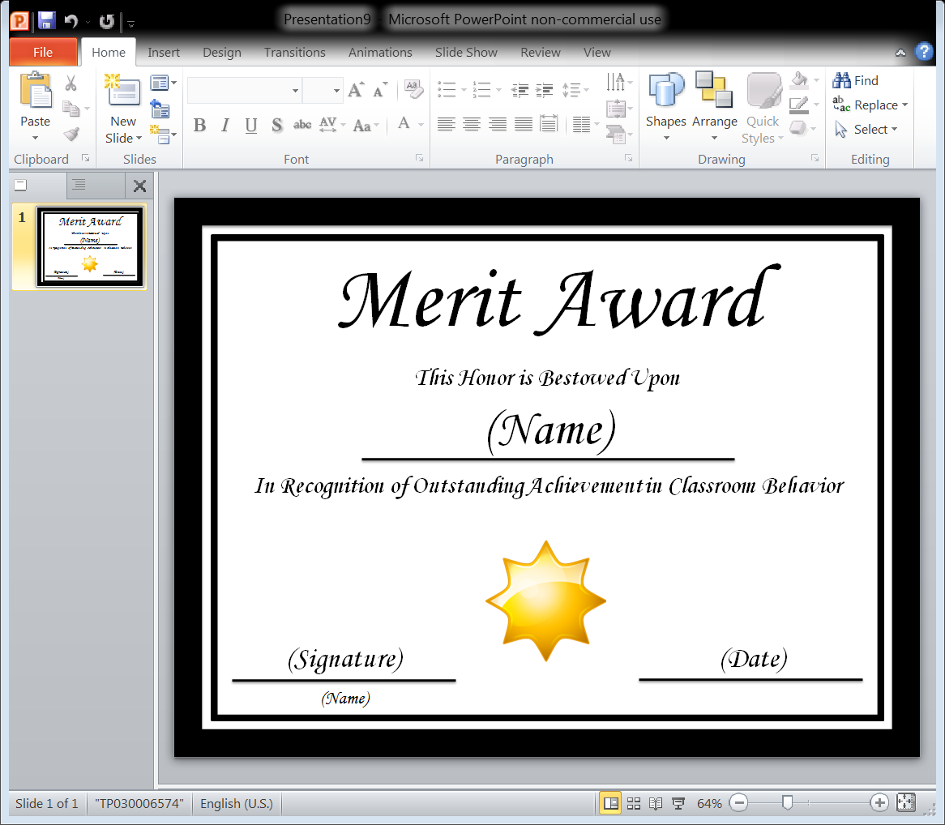

Slide 25
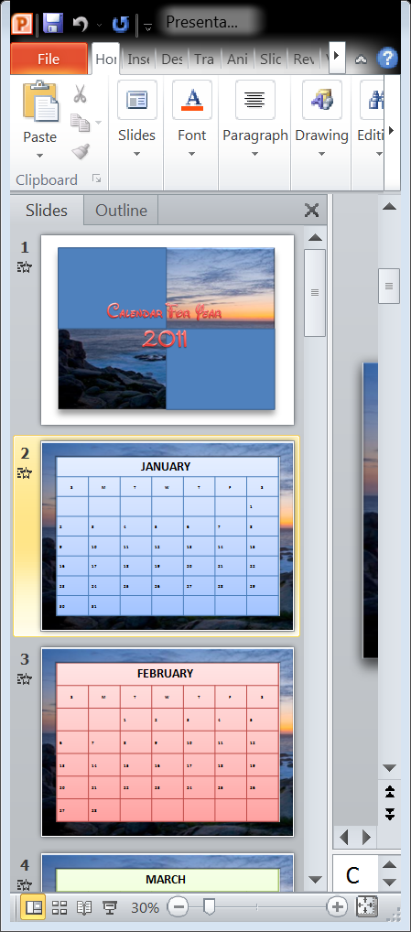
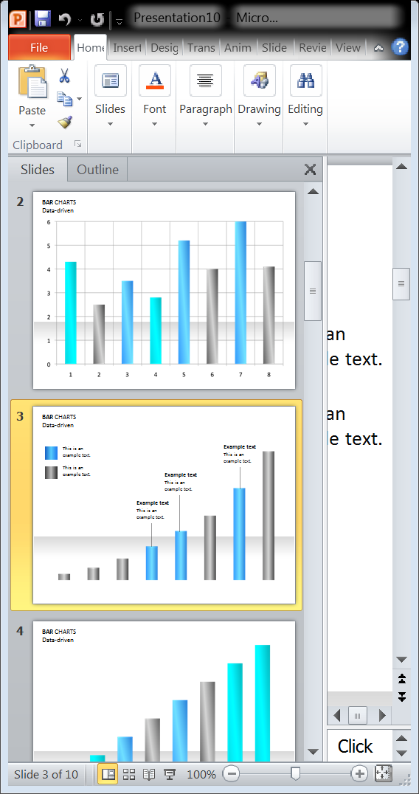

Slide 26
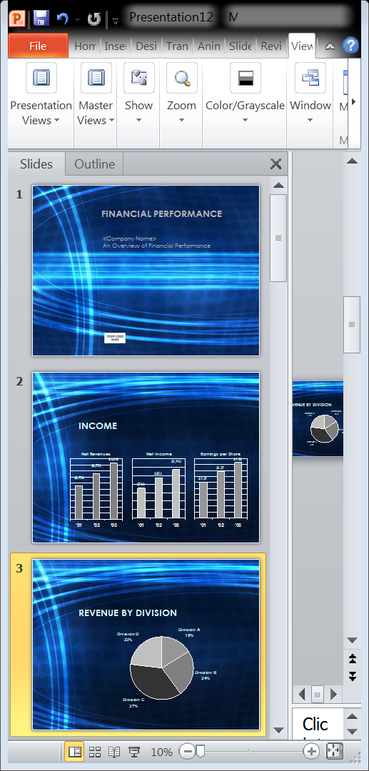
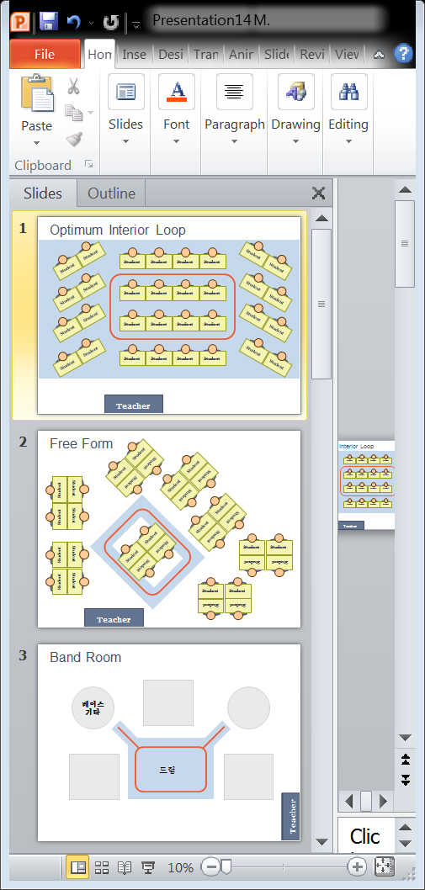

Slide 27

You.
Two, Four & Seven Day
Rejuvenation Packages
Gourmet Meals
Private Beach Massage
Beach Yoga &
Exercise with
Certified Instructors
Nutritional Evaluations
In-Room Facials,
Massages & Treatments
Salon Hair Care
Private Counseling
& Therapy
Only Better.
Business Name Here
Business Address Here
Business Phone / Cell Phone Here
Website Here
Email Address
Facebook URL
Twitter URL
Gardenview Spa
& Salon
Notes:
Welcome to Super Easy Templates:
This is an 8 x 11 Landscape PowerPoint Brochure that’s perfect for any spa, salon, massage, meditation, or self-help business. Quickly and easily modify the text. Add your own business name, city, and state. Inside write in your own business’ services, along with how your new customers can contact you. Super Easy Templates provides easy-to-use customizeable templates for home and business use. Most of our templates are for PowerPoint 2007 and Word 2007. If you are interested in additional templates, visit our website: www.supereasytemplates.com. This graphic is from the online Microsoft Clipart Gallery. Update the photo with another or use this lovely graphic. Please leave us a 5 star rating if you love this template!

Slide 28
Text는 문장별, 단어별, 글자별로 Animation이 가능하다.
The End
Press key “Esc” to close

Slide 29
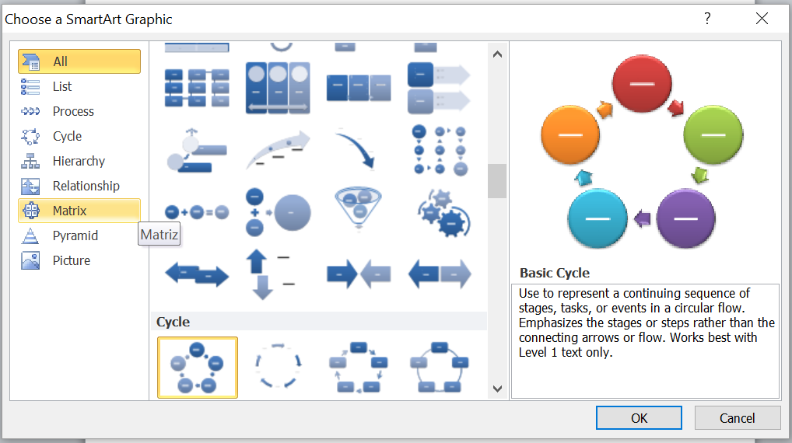
SmartArt 사용

Slide 30
샘플 PowerPoint SHows

Slide 31
PLEASE NOTE:
This PowerPoint is intended to be remodeled for the purposes of SlideFest.
ees are wonderful and here’s why.

Slide 32
BEES ARE A NECESSARY PART OF THE EARTH’S ECOSYSTEM.

Slide 33
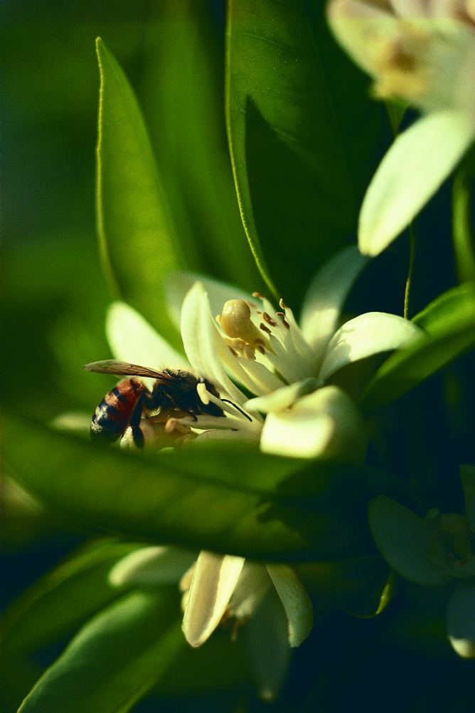
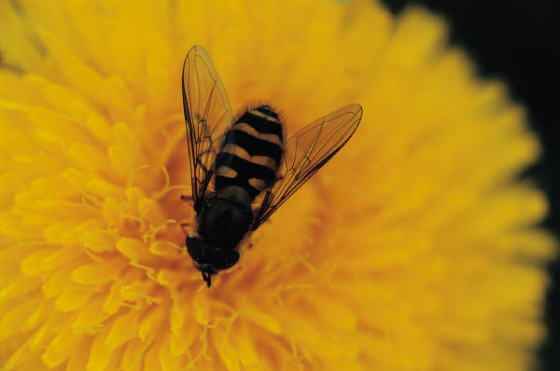
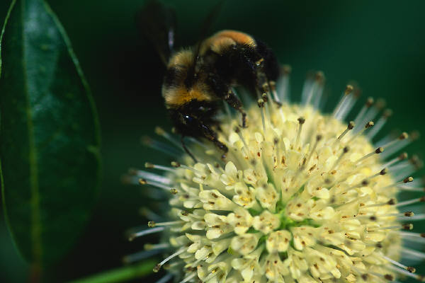
BEES love flowers and help spread plant pollen.

Slide 34
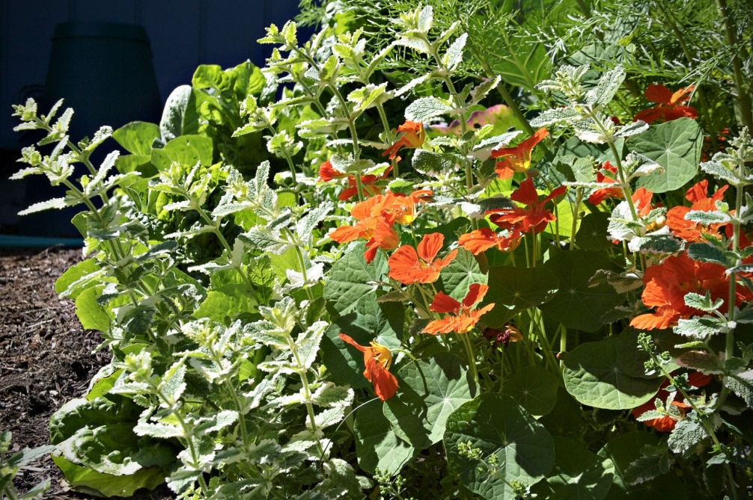
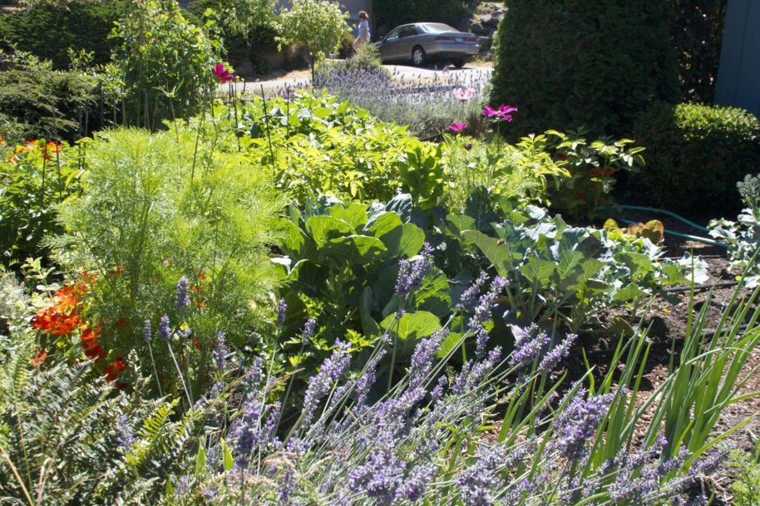
Spreading pollen helps flowers multiply and grow.

Slide 35
There are several kinds of bees:
Eusocial & Semisocial Bees
  Bumblebee
  Stingless bee
  Honey bee
  Africanized honey bee
Cleptoparasitic Bees
  Cuckoo bee
Solitary & Communal Bees
  Orchard Mason bee
  Eastern Carpenter bee
  Alfalfa Leafcutter bee
  Hornfaced bee
SOURCE: http://en.wikipedia.org/wiki/Bee

Slide 36
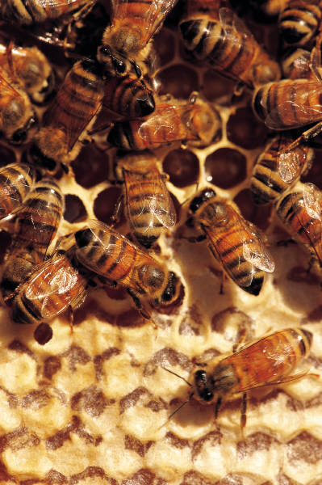
A majority of bee species live in a hive.
Up to 100,000 individual bees can live in one hive!
Can you imagine the patience necessary to live with that many roommates?!
SOUCE: http://en.wikipedia.org/wiki/Bee#Bumblebees

Slide 37

There is one queen bee in every hive who lays eggs.
SOUCE: http://en.wikipedia.org/wiki/Queen_bee

Slide 38
A queen bee can lay up to
2,000
eggs every day!
She lays more eggs than her own body weight everyday!
SOUCE: http://en.wikipedia.org/wiki/Queen_bee

Slide 39
Even though all bees have the same Scientific classification, they all have different traits that make them special.
KINGDOM | ANIMALIA
PHYLUM | ARTHROPODA
CLASS | INSECTA
ORDER | HYMENOPTERA
SUBORDER | APOCRITA
SUPERFAMILY | APOIDEA
SOUCE: http://en.wikipedia.org/wiki/Queen_bee

Slide 40
But the best bees make deliciously sweet honey!

Slide 41
A1
A2

Slide 42
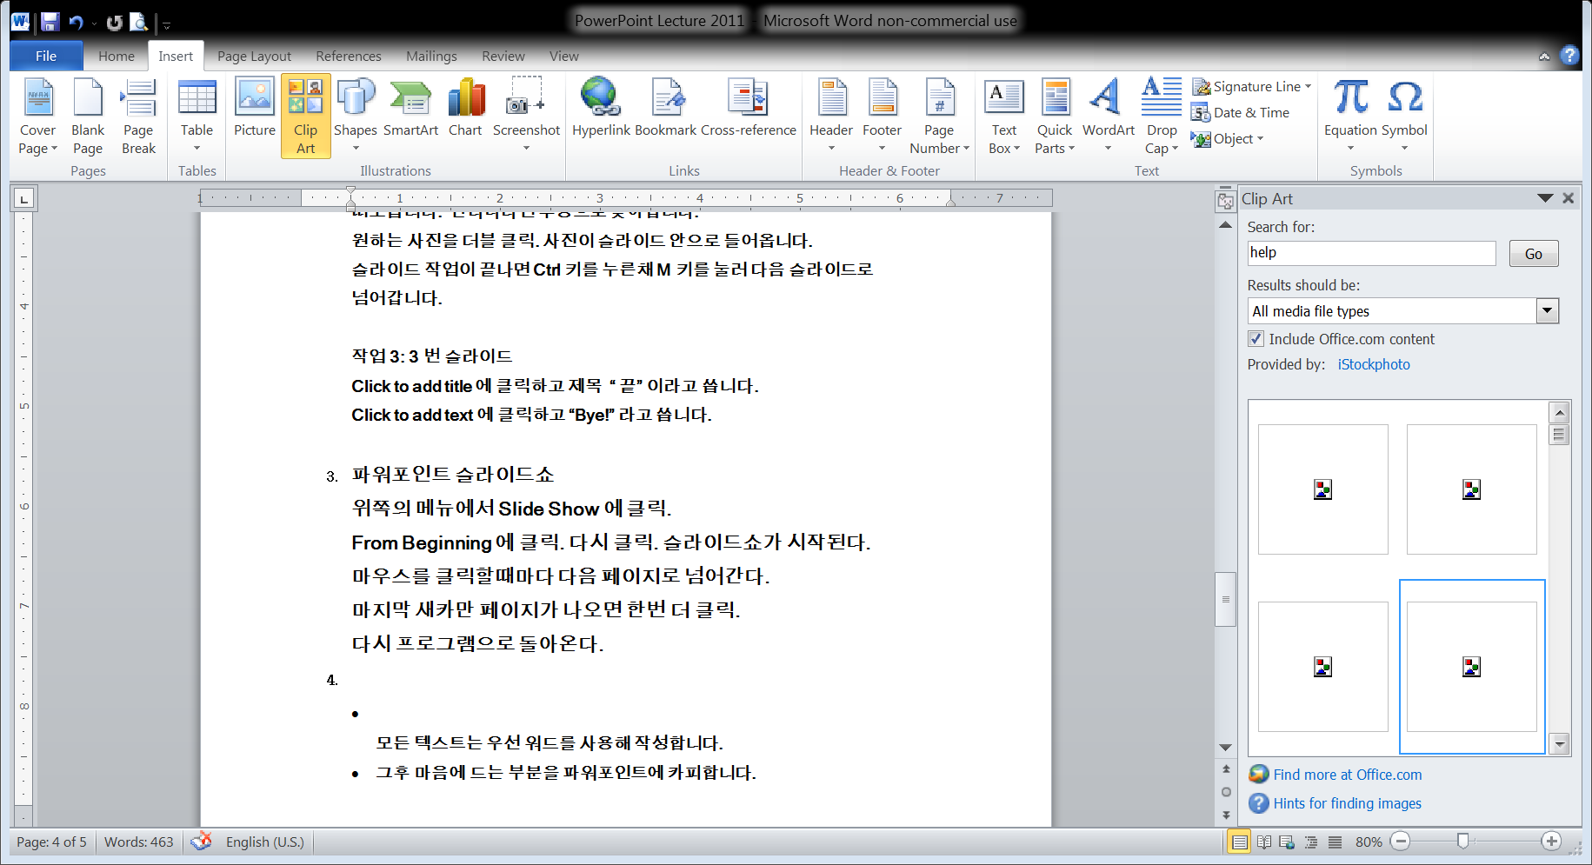
Using Insert > Images > Screenshot you insert any opened window directly

Slide 43
슬라이드를 만들떄 많이 쓰는 화면들
Questions/Discussions
Question One
  Discussion
  Discussion
Question Two
  Discussion
Questions Three
  Discussion
Notes:
An opportunity for questions and discussions.

Slide 44
Schedule
Class/Week | Topic | Reading | Assignment
1 | 파워 포인트 1 | Chapter 1
2 | 파워 포인트 2 | Chapter
3 | 파워 포인트 3 | Chapter
4 | 파워 포인트 4
Notes:
A schedule design for optional periods of time/objectives.

Slide 45
Objectives and Results
Objectives
  Course objective 1
  Course objective 2
  Course objective 3
Results
  Expected results
Skills developed
  Skill 1
  Skill 2
Notes:
Objectives for instruction and expected results and/or skills developed from learning.

Slide 46
Vocabulary
Term One
  Definition A
  Definition B
Term Two
  Definition
Term Three
  Definition
Notes:
Relative vocabulary list.

Slide 47

Procedures/Lecture Slide
Add procedure here
  Step one
  Step two
Notes:
A list of procedures and steps, or a lecture slide with media.

Slide 48
파우어포인트 Presentation
감사합니다.
강의 신청은
중앙 교육센터
213.368.2545

